Slide 1
Skybank
Taking over home banking

Slide 2
Technologies
HTML
CSS
React
TypeScript
Java
PostgreSQL
Redux
Axios
Maven
Javalin
DBeaver
JavaScript

Slide 3
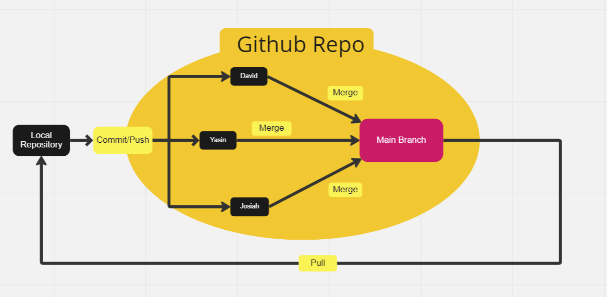
GitFlow

Slide 4
Team Structure
David: GitFlow, Frontend
Yasin: Fullstack
Josiah: Backend
Robel: Team Leader

Slide 5
Architecture Diagram
Web Client
HTTP Response
HTTP Request
Client Side
Server Side
Controller
Service
Repository
SQL

Slide 6
Agile/Scrum Implementation
Daily Standup
Updated Trello Board
Story points
Spring Planning
Sprint Review
Sprint Retrospective
Working Software (Over Comprehensive Documentation)

Slide 7
ERD Diagram
This is showing how the tables relate to one another inside the data base

Slide 8
Implemented Features

Slide 9
Issues and Defects

Slide 10
Challenges Faced
Unit Testing
Pipeline Build Statistics

Slide 11
Demo

